Slide 1



Examining Coexistence in a Simulated Microbial Environment for Agnostic Life Detection
Charly Bisson
Advisors: Sara Walker, Cole Mathis

Slide 2
01
Background
2

Slide 3
Astrobiology = Search for life!
… What do we look for?
3

Slide 4
Biosignatures:
Measurable aspect of an environment whose production can only be attributed to life.
Key for life detection!
4

Slide 5
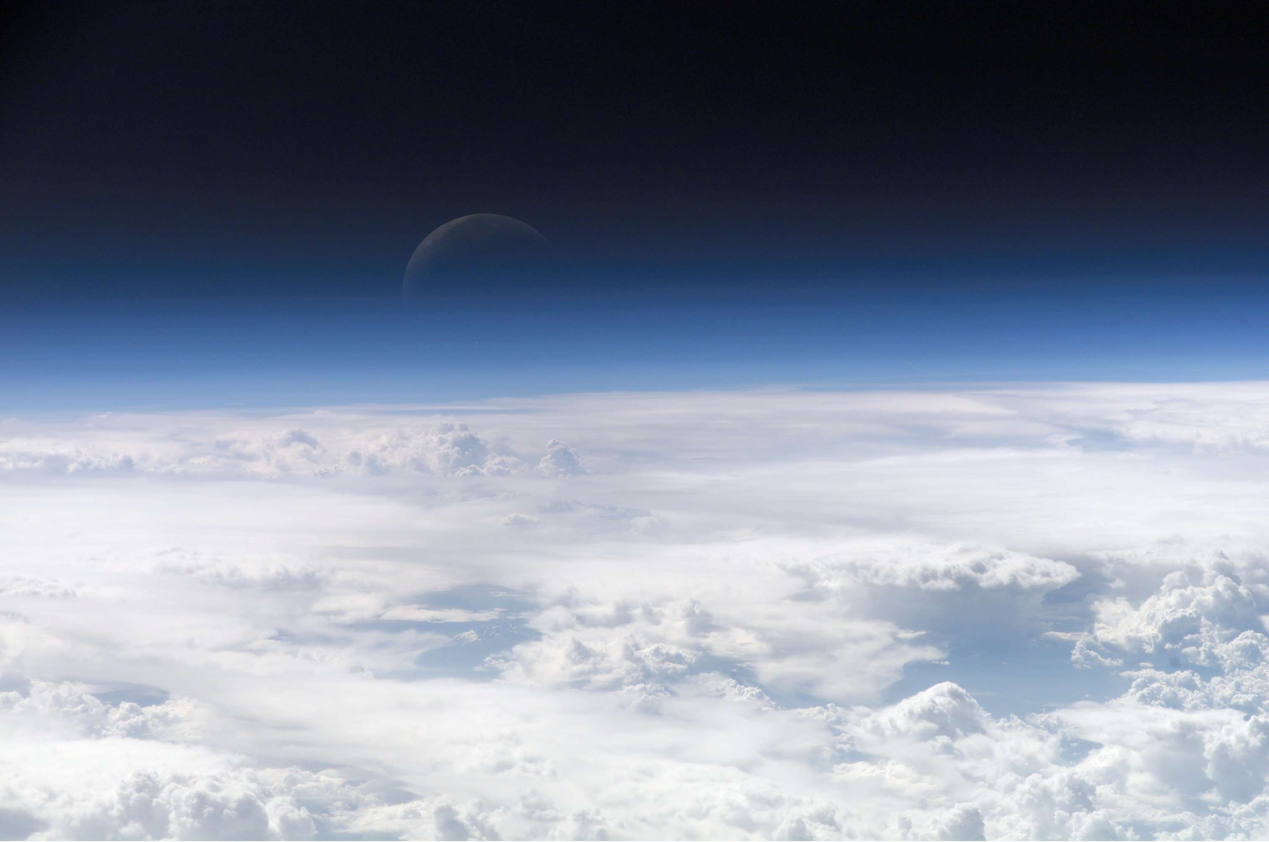
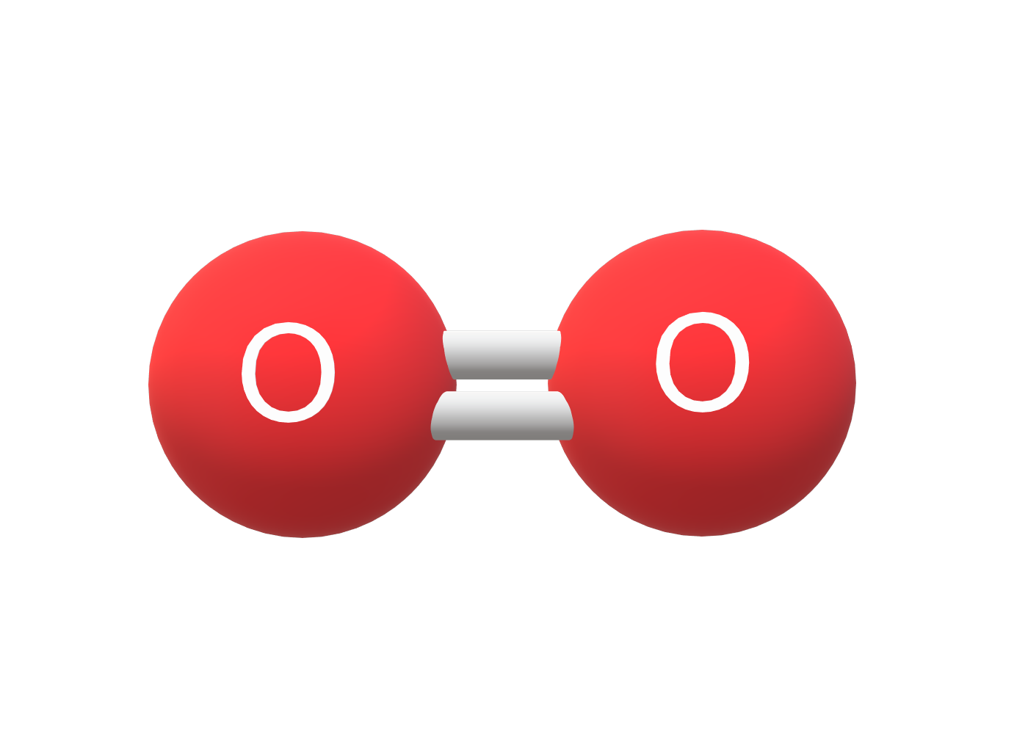
(Wikipedia)
6

Slide 6
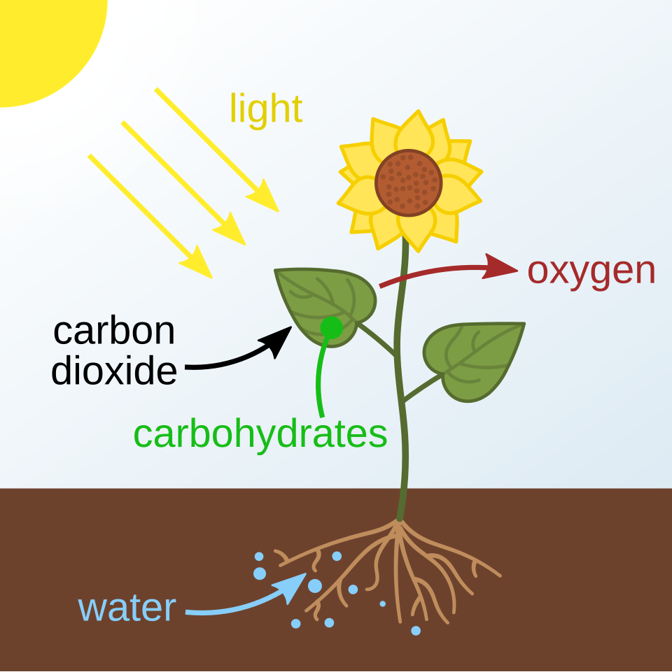
Biosignatures are tied to theories of life
“What life is is what life does”
(Wikipedia)
7

Slide 7
Problem:
No universal theory of life!
Biochemical biosignatures are biased towards Earth
Ex) Photosynthesis
8

Slide 8
Solution:
Agnostic Biosignature
Doesn’t rely on specific biochemistry
Broadens detection capabilities
12

Slide 9
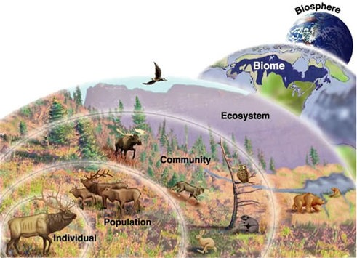
Unique: Ecosystem-level biosignature
Life on Earth always around other life; same likely true for extraterrestrial life!
What new measurements are more relevant at the ecosystem level?
13
Notes:
AT END: therefore agnostic, ecosystem-level biosignatures become a viable area of exploration

Slide 10
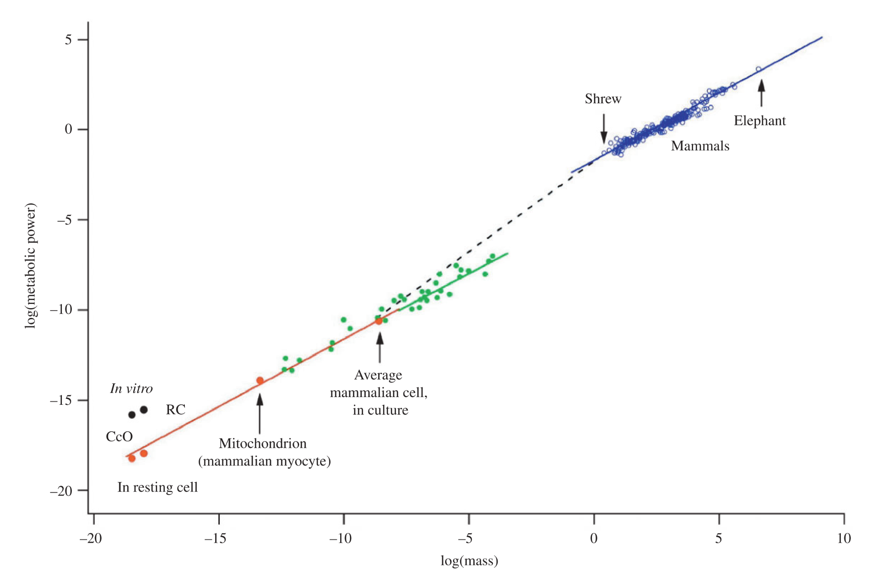

Allometric scaling
Form:
$$Y=aM^{b}$$
Physiological processes change with size
Ex. Larger animals having faster basal metabolic rate
Metabolic power (log)
Widely observed
All sizes
All taxa
All levels of processes
Mass (log)
(West et al., 2005)
14
Notes:
From animals to the internal processes of unicellular microbes (!!!)

Slide 11
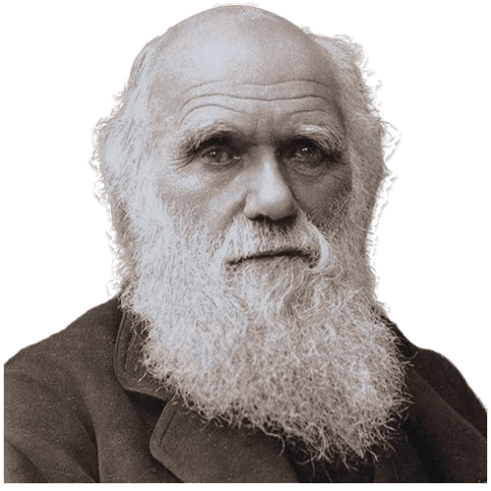
Why so universal? Evolution
Optimization of:
- resource usage
- resource transport
- reaction rate
For species of different sizes
Energy utilization through space and time
- First principles in physics
15

Slide 12
OBJECTIVE: observe this universal phenomenon
Measurable, agnostic byproducts of scaling prevalent at the ecosystem level
Start by modeling an ecosystem
16

Slide 13
The Model
17

Slide 14
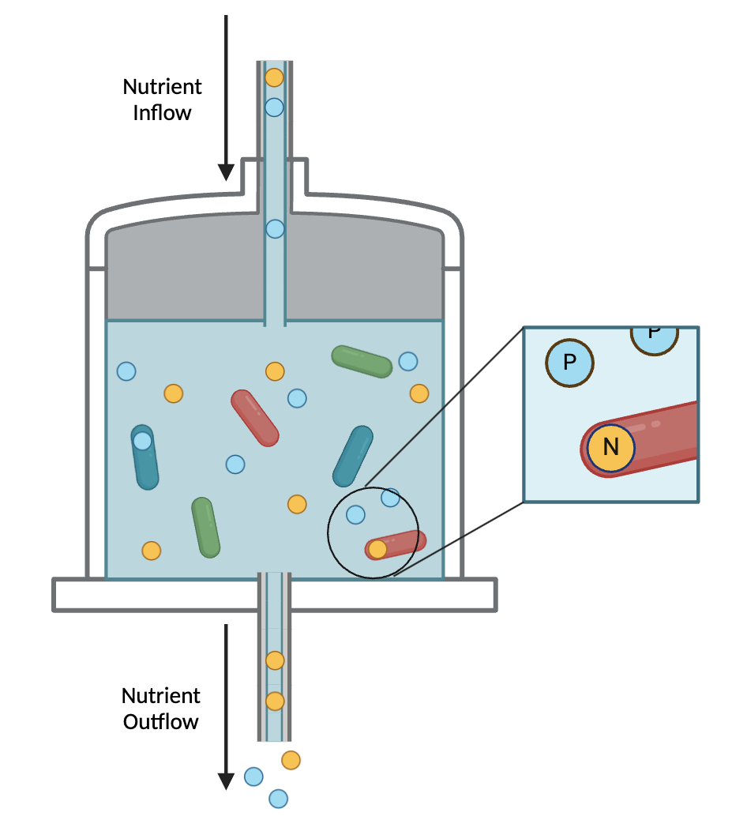
Kempes General
Chemostat Model
Originally used to model phytoplankton growth experiments
Computational simulation
Very simple microbial ecosystem
18

Slide 15
How it works:
Consumer-resource model
  Ecological model where multiple consumers vie for the same resources without any interactions other than competition
Ordinary differential equations (ODEs)
  Have only one independent variable (time)
19

Slide 16
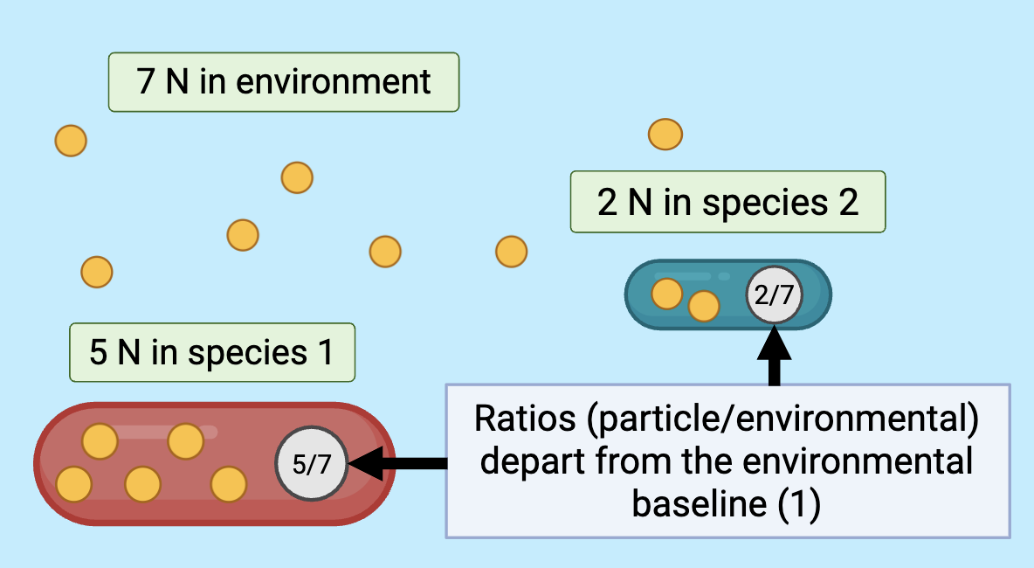
The Associated Biosignature
Differences in resource abundance internal and external to a cell
21

Slide 17
Prerequisite to this Biosignature:
Coexistence
An ecosystem is organisms coexisting together
22

Slide 18
Goal: Test validity of assumptions made in previous literature
Does computational simulation produce the theorized results?
23

Slide 19
02
Methods
24

Slide 20



Dependent Variables of the Model
N – Biomass (cells/m³)
- How many cells of each species are present
- One biomass value per species (3 total)
R – Environmental Resources (mol/m³)
- How much of each resource is in the chemostat environment
- One value per resource (2 total)
Q – Cellular Quota (mol/cell)
- How much of each resource is being stored internally
in each cell
- One quota per resource per species (6 total)
25

Slide 21
26

Slide 22
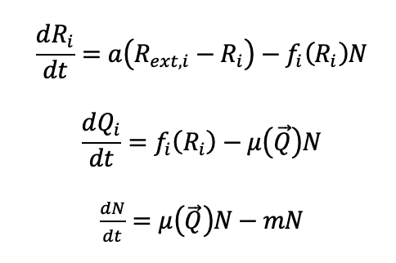
Differential Equations of the Model
11 total in the three species two resource case
(1)
(2)
“i” denotes a specific resource
(3)
Observed empirically to scale with volume
27
Notes:
Split into three slides, one for each dep variable

Slide 23

Attempting to Achieve Coexistence
37

Slide 24
How to achieve coexistence: modify the cellular mortality rate (m)
Broadly accounts for dynamics like variable predation, sinking rates, phage susceptibility, or intrinsic death
28

Slide 25
“Classic resource competition theory in equilibrium…indicates that for multiple species… to coexist on a single limiting resource they must all share the same R* value”
(Kempes et al. 2021).
29

Slide 26
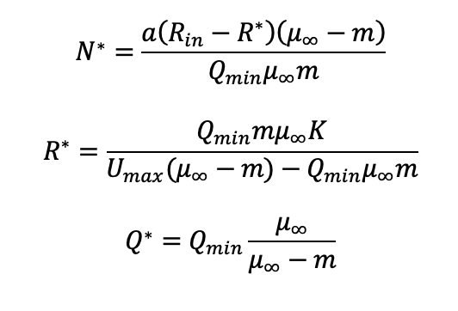
Steady State equations from Kempes et al., 2021
(4)
(5)
(6)
32

Slide 27
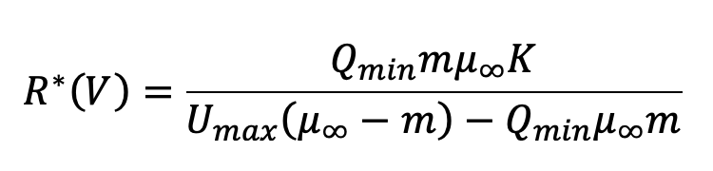
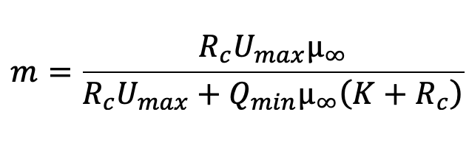
(5)
(Assume that R*(V) is at constant value notated R_{c})
(7)
scale with volume
30

Slide 28
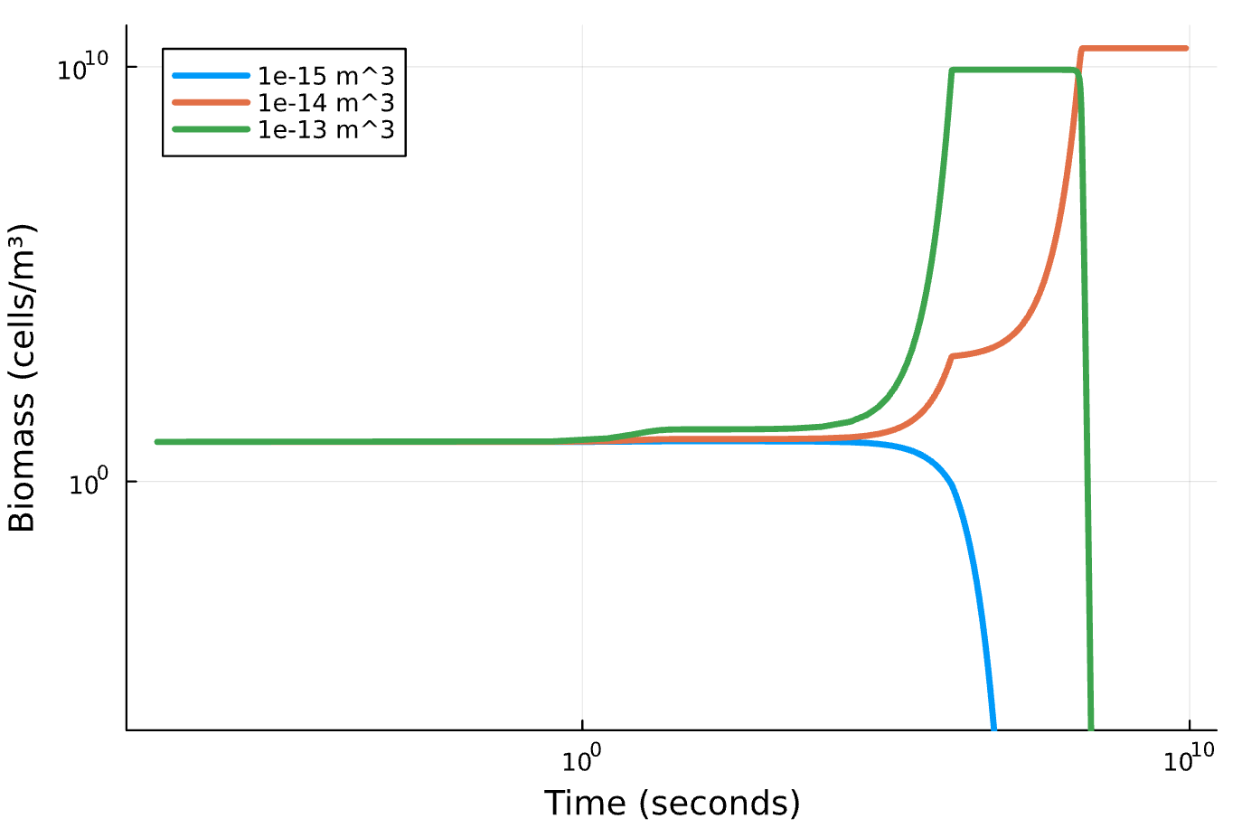
Mediation Through Mortality Rate
No coexistence either!!
36

Slide 29
03
Conclusions
41

Slide 30
The model needs adjustments
Unable to achieve coexistence despite basis in biological theory
- Current assumptions: insufficient
- Instability within analytical results
- Differences in assumptions?
42
Notes:
Add back practical applications

Slide 31
We should keep going!
Agnostic, ecosystem-level biosignatures are a promising direction
Greater range of detection
- Overcome Earth biochemistry bias
Ecosystem-level measurements provide plenty of ground to explore
Modeling essential to refining potential biosignatures!
44

Slide 32
Next steps:
Interspecies interactions
Detritus
Agent based model instead of consumer-resource?
45

Slide 33
Thank You!
46

Slide 34
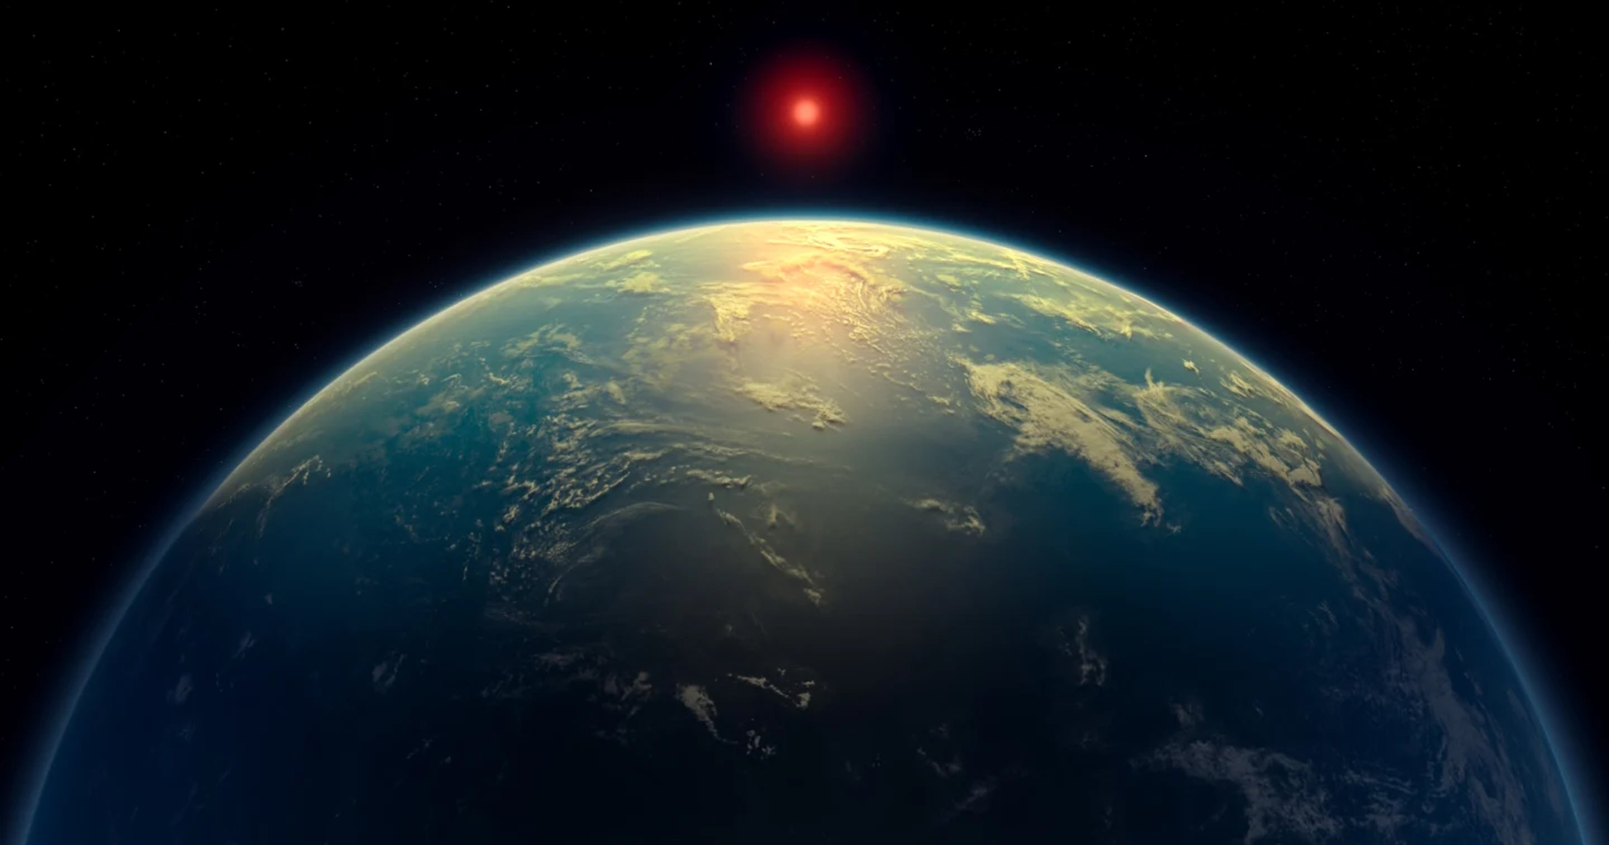
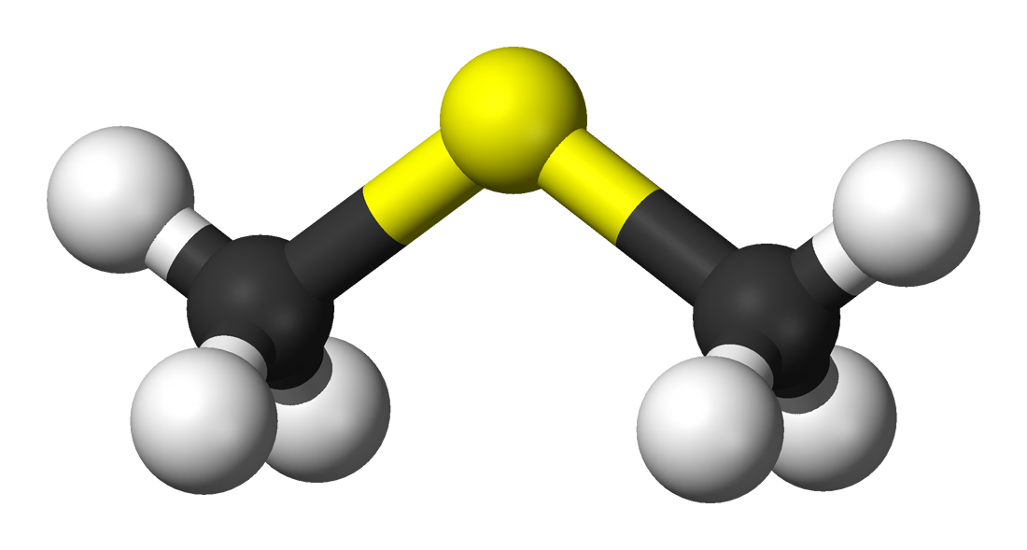
False Positive
Classifying abiotic measurement as originating biologically
- Declaring “this came from life!” when it didn’t come from life
Ex) Exoplanet
K2-18b and
DMS
(Scientific American)
10

Slide 35
False Negative
Classifying biotic measurement as originating abiotically
- Declaring “this didn’t come from life” when it did come from life
Ex) Oxygen on
Earth before the Great
Oxidation Event
11

Slide 36
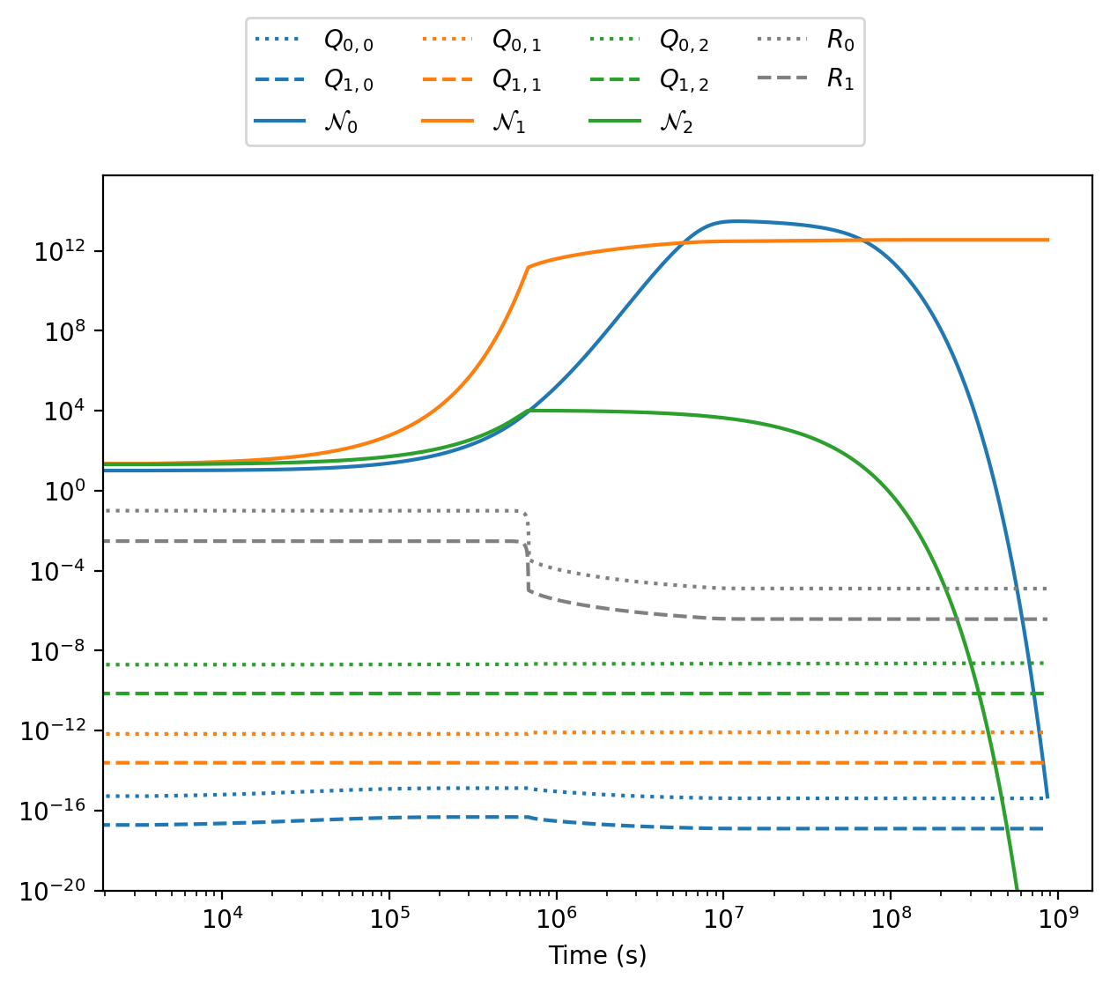
Three Species Case - No coexistence!
35

Slide 37
Steady States
AKA fixed points
Notated with an asterisk (ex. R* is the steady state of the resource equation)
Point at which an ODE reaches equilibrium
  Necessary in ecosystem!
20

Slide 38
Unexpected results… Let’s analyze the steady state solutions!
37

Slide 39
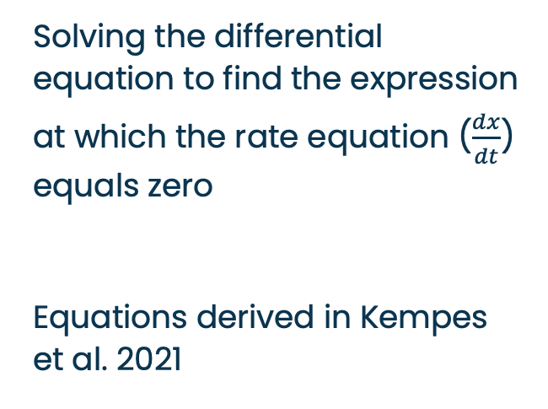
Analytical (algebraic)
Solving the differential equation to find the expression at which the rate equation ($\frac{dx}{dt}$) equals zero
Equations derived in Kempes et al. 2021
(4)
(5)
(6)
32

Slide 40
Numerical
Passed through a computational solver, which evaluates an initial value problem over a length of time given an initial condition
DifferentialEquations.jl package
- Produces a graph tracking changes in values for each dependent variable over the given timeseries
33

Slide 41
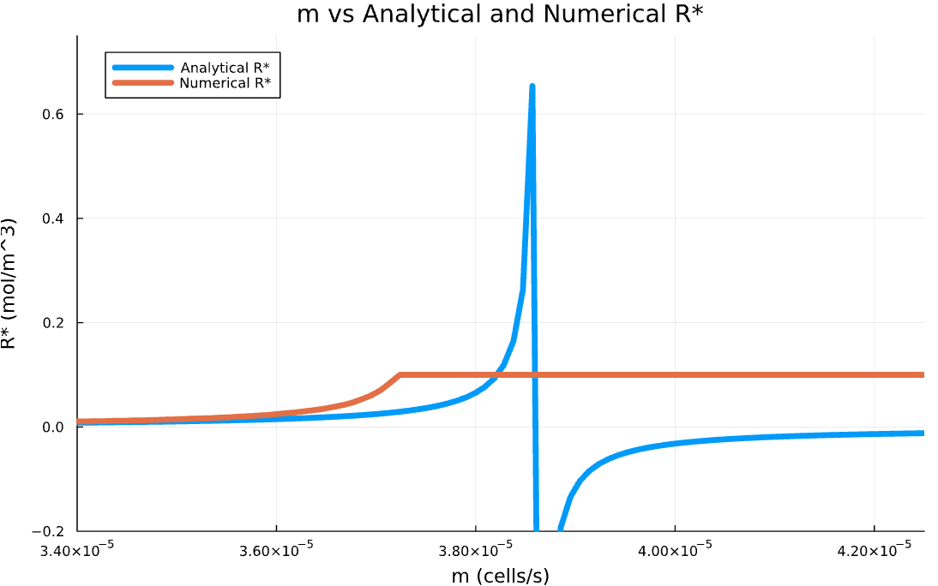
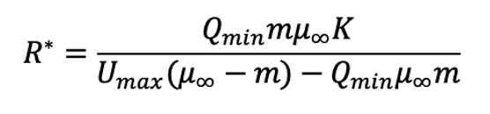
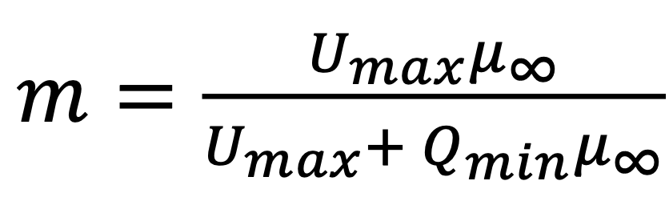
R*
38

Slide 42
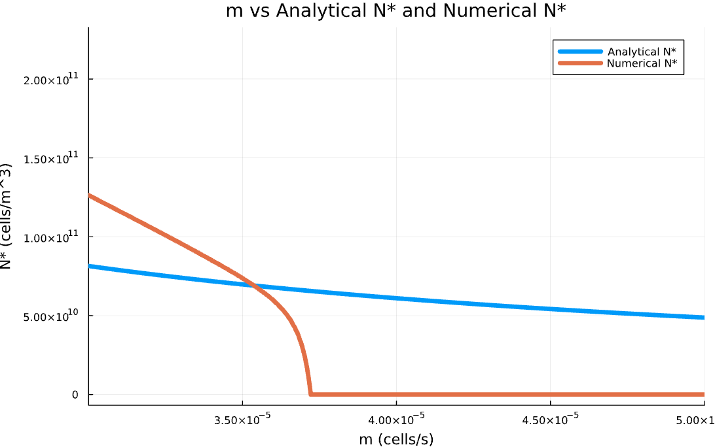
N*
39

Slide 43
Biggest takeaway: They’re different
Numerical solutions finding steady states not accounted for in analytical solution! Could be numerical instability
40

Slide 44
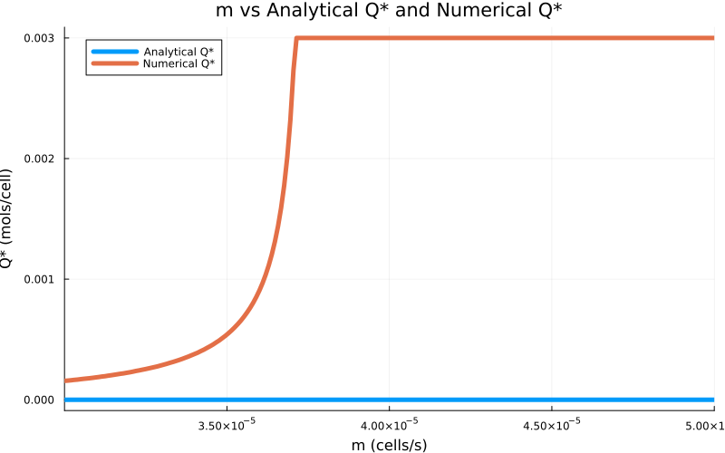
Q*
48

Slide 45

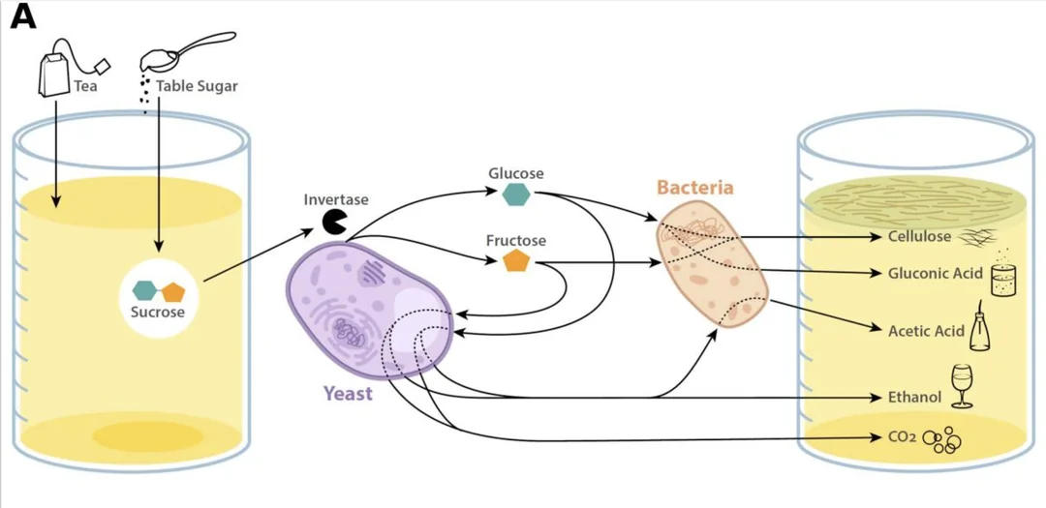
Potential experimental analog: Kombucha
Conditions similar to the model are difficult to find occurring naturally
However, kombucha: symbiotic microbial community in contained environment
Differences: interactions between microbial species, resource inflow
and outflow not constant but periodic,
not well-mixed
(May et al., 2019)
43
Notes:
https://pmc.ncbi.nlm.nih.gov/articles/PMC6730531/

Slide 46
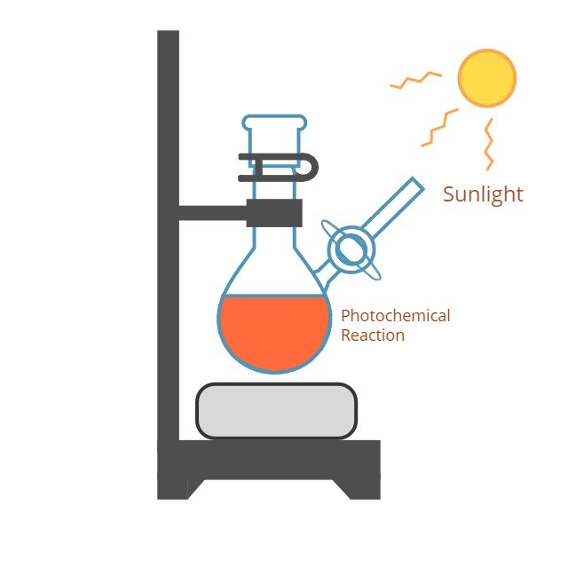
Abiotic DMS pathway
(San-Novo et al., 2025): detected on comet
(Reed et al., 2024): DMS and other organosulfur production from photochemistry
  Gas-phase products of H₂S/CH₄/N₂ haze photochemistry
  K2-18b atmosphere: high CH₄ and
(ChemTalk)
49

Slide 47
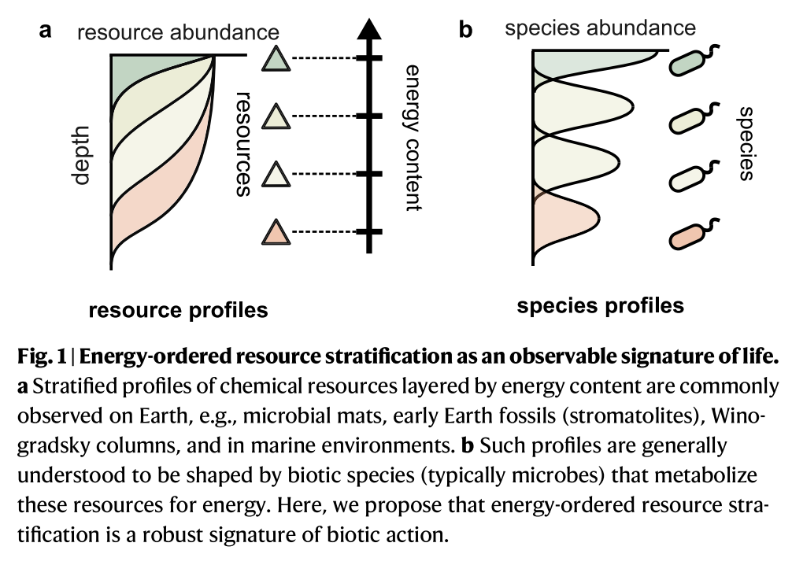
Resource stratification
Other ecosystem-level biosignature
(Goyal et al., 2025)
49

Slide 48
Instabilities
- Finite machine precision
- machine epsilon (smallest number computer
can differentiate from zero)
- roundoff errors
Analytical instability:
Unstable / inaccessible fixed point
49

Slide 49
ODE Solver in Julia: AutoVern7(Rodas5)
Stiffness: large jump in value
Stiffness aware
For nonstiff portions, detects that pattern and solves less
For stiff portions, detects stiff jump, solves many times in that area
More optimized!
49

